Slide 1


SMART ITR
CHATBOT
Zenith
Bharati Vidyapeeth College of Engineering Pune, Pune,Maharashtra

Slide 2


PROBLEM STATEMENT
Smart ITR Filing Chatbot: Create a chatbot to recommend ITR forms, suggest tax-saving investments, ensure data privacy, and support seamless platform integration.

Slide 3

[Duplicate this slide and add your data]
PROPOSED SOLUTION
ARCHITECTURE
INNOVATION
SOCIAL/MARKET IMPACT
Solution Architecture:
User Interface: React.js/Vue.js integrated with Rasa/Dialogflow for seamless chatbot interaction.
Back-End: Node.js/Python handles logic; MongoDB/PostgreSQL for data storage.
NLP Engine: Rasa/Dialogflow processes natural language for personalized ITR filing & tax-saving advice.
Cloud Infrastructure: AWS/Google Cloud for hosting and scaling.
Security: SSL, JWT, and AES encryption for data protection and GDPR compliance.

Slide 4
[Duplicate this slide and add your data]
PROPOSED SOLUTION
ARCHITECTURE
INNOVATION
SOCIAL/MARKET IMPACT
Innovation & Market Impact:
Accessibility: Simplifies tax filing and financial services for users, available 24/7.
Financial Empowerment: Educates users on tax savings, driving better financial decisions.
Efficiency Gains: Streamlines tax filing, reducing errors and administrative burden.
Market Impact: Increases tax compliance and enhances economic growth by boosting government revenue

Slide 5
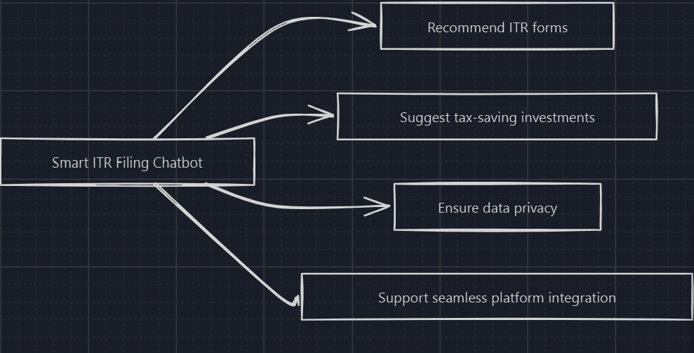
[ARCHITECTURE]
Front-End:React.js for dynamic UI, Material UI / Tailwind CSS for responsive design.
Chatbot & NLP: Dialog Flow for quick NLP integration
Back-End: Node.js for fast server-side processing ,Express.js for managing APIs.
Database: MongoDB for flexible and quick data storage.
Cloud & Hosting: Heroku for easy deployment
Security: JWT for user authentication, HTTPS for secure data transmission.
FLOW CHART
TECH STACK
Smart ITR ChatBot
PROTOTYPE

Slide 6
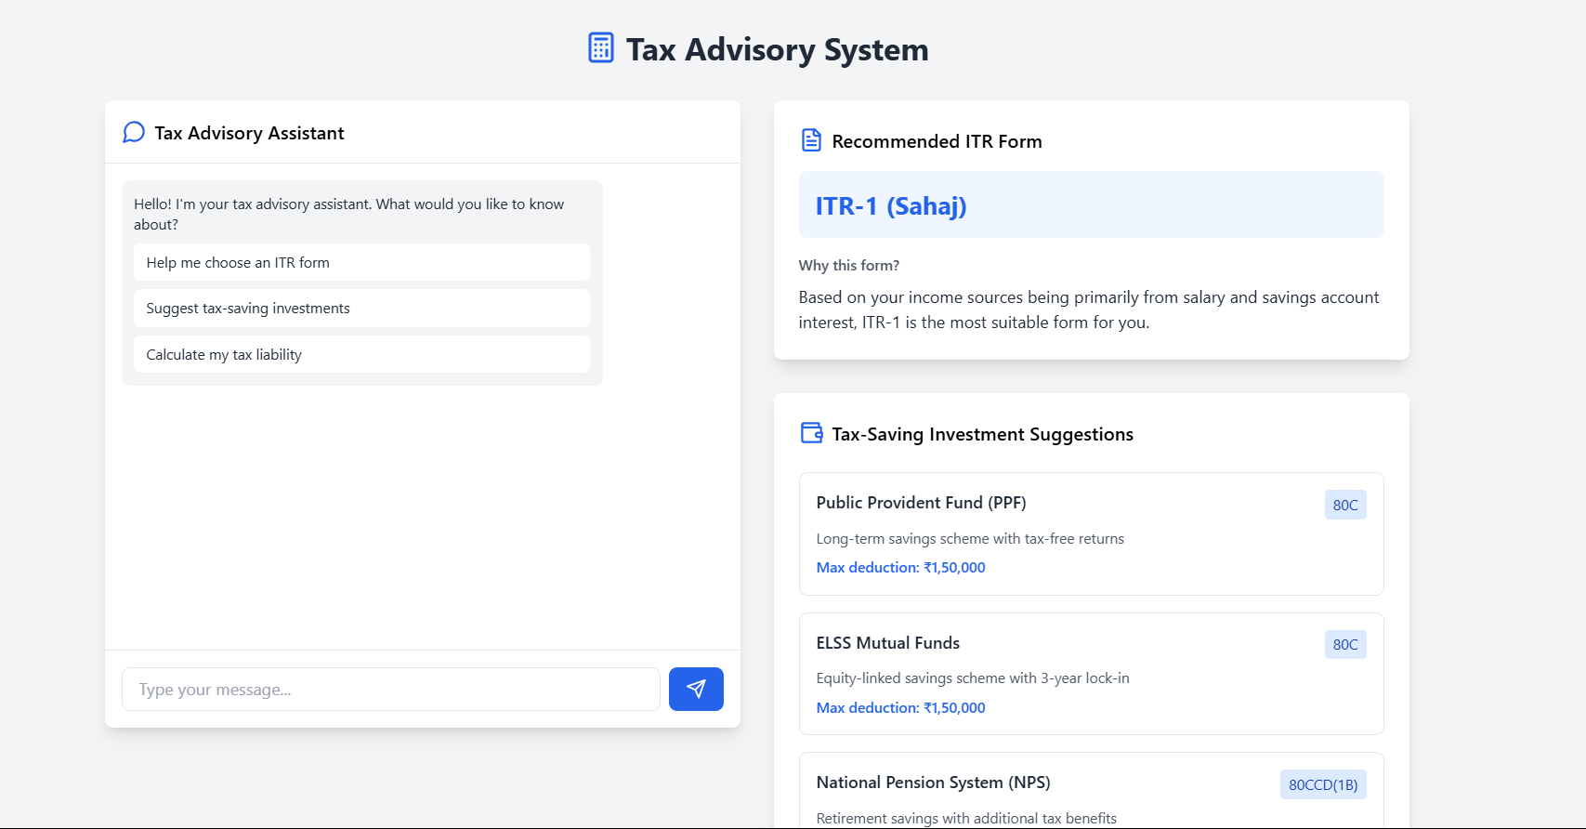

Slide 7
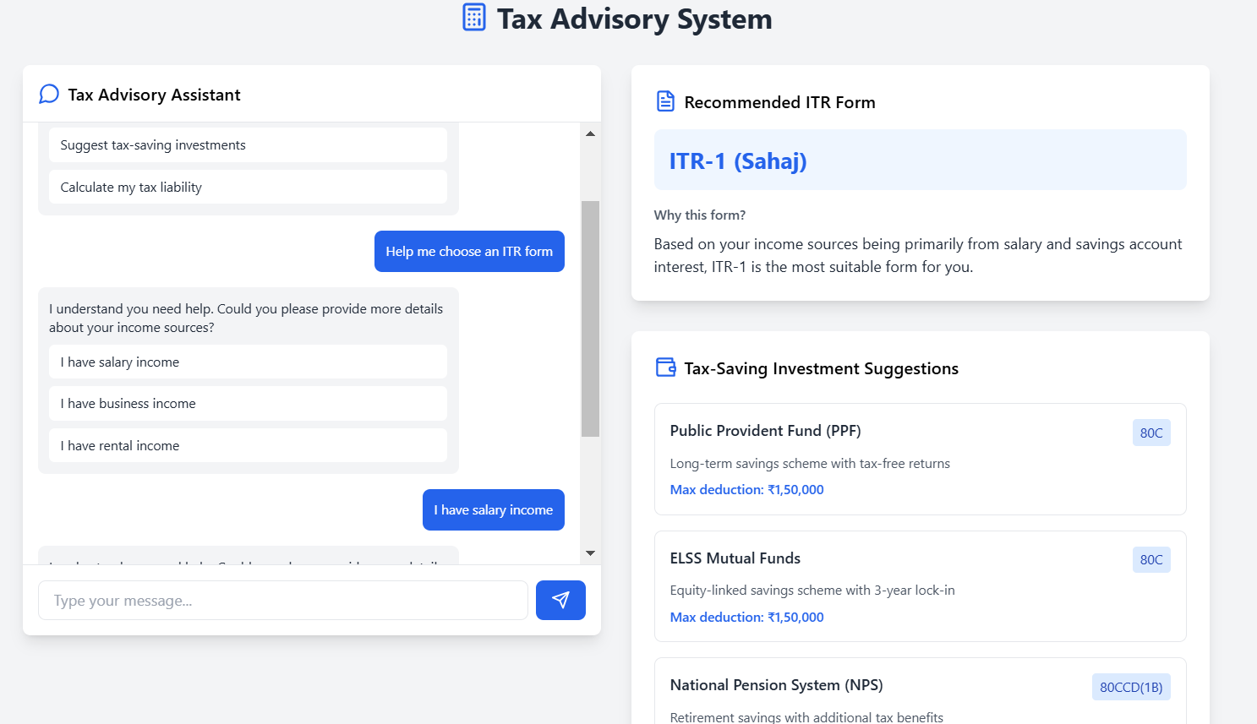

Slide 8
THANK YOU
ABOUT ZENITH
Aditya Singh,3rd year-ECE,Bharati Vidyapeeth College of Engineering Pune
Mail ID: adityasingh.gdscgenai@gmail.com
Sarvesh Sorte,3rd year-ECE,Bharati Vidyapeeth College of Engineering Pune
Mail ID: sarvesh.1414sorte@gmail.com
Savita Srivastava,2nd year-CSBS,Bharati Vidyapeeth College of Engineering Pune
Mail ID: shambhala.srivastava@gmail.com

